Slide 1
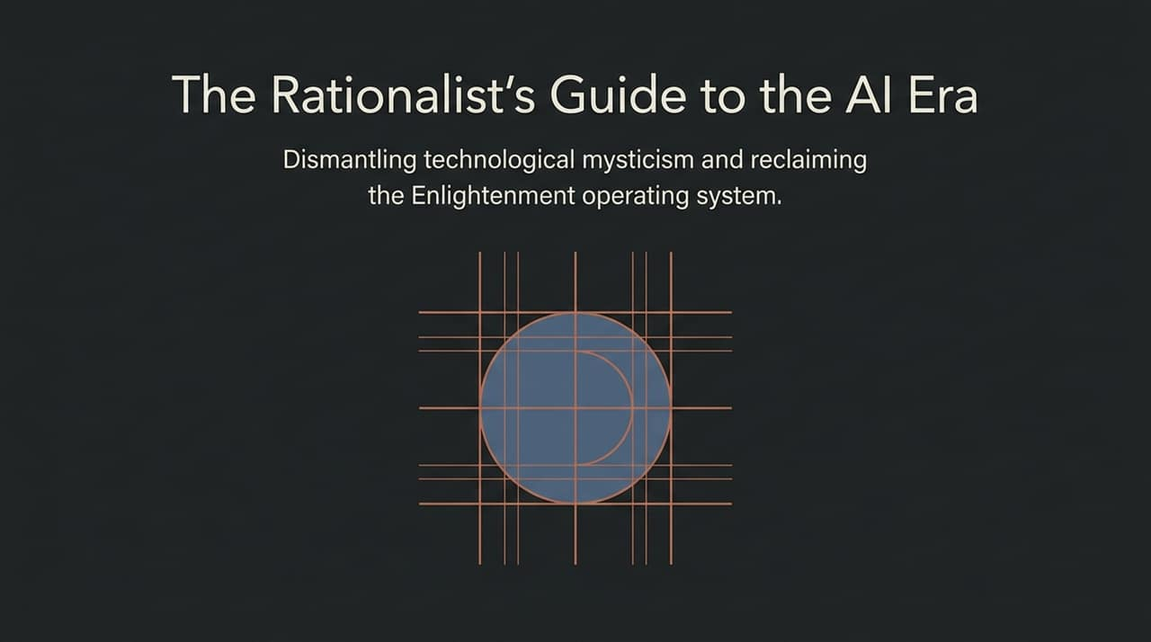
Notes:
Welcome, everyone. Today, we are taking a step back from the daily cycle of hype, fear, and sensationalism surrounding artificial intelligence. We’ve titled this talk 'The Rationalist’s Guide to the AI Era: Dismantling technological mysticism and reclaiming the Enlightenment operating system.'
Right now, public discourse about AI tends to swing between two extreme ends: either apocalyptic dread—where AI turns into an all-powerful deity that destroys civilization—or quasi-religious worship, where tech leaders promise omniscient superintelligences that will magically solve every human problem.
Both of these extremes share a common flaw: technological mysticism. They treat code and software as if they transcend the physical world.
In this presentation, inspired by cognitive psychologist Steven Pinker’s rationalist perspective, we will dismantle these myths. We will reframe AI not as a deity or a miracle, but as an engineering tool—one that operates under the laws of physics, computer science, and information theory. More importantly, we will explore why maintaining our humanistic, Enlightenment-era values—reason, science, and rigorous safety standards—is the only sane path forward as we navigate the 21st century.
https://www.youtube.com/watch?v=eWC47agaKpk

Slide 2
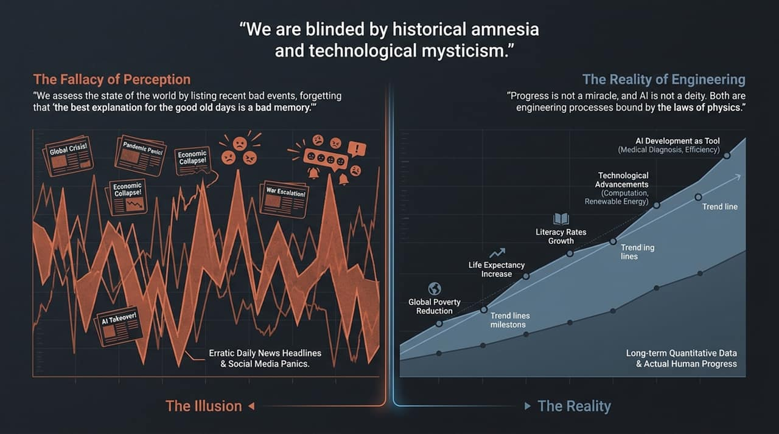
Notes:
Let’s start with how we perceive the world. If you open your phone right now, look at social media, or watch the morning news, it feels like the world is collapsing around us. Headlines shout about pandemic panics, economic ruin, escalating wars, and imminent AI takeovers.
As Steven Pinker points out, this creates 'The Fallacy of Perception.' We assess the state of the world simply by listing recent bad events, completely forgetting that bad events have always occurred throughout human history. There is a great line quoted on this slide: 'The best explanation for the good old days is a bad memory.'
When we rely on news headlines, we are trapped by availability bias. The news reports on sudden, dramatic events—a plane crash, a war outbreak, a terrifying AI demo. The news almost never reports on slow, steady, positive trends. You will never see a headline that says: 'Yesterday, 137,000 people escaped extreme poverty.' Yet that has been the daily average over recent decades.
Look at the bottom half of the slide. While headlines spike up and down in erratic panics, the long-term trend lines of global human progress—such as literacy rates, global poverty reduction, and life expectancy—show steady, compounding improvements over time. To understand AI and society rationally, we must separate daily noise from quantitative reality.

Slide 3
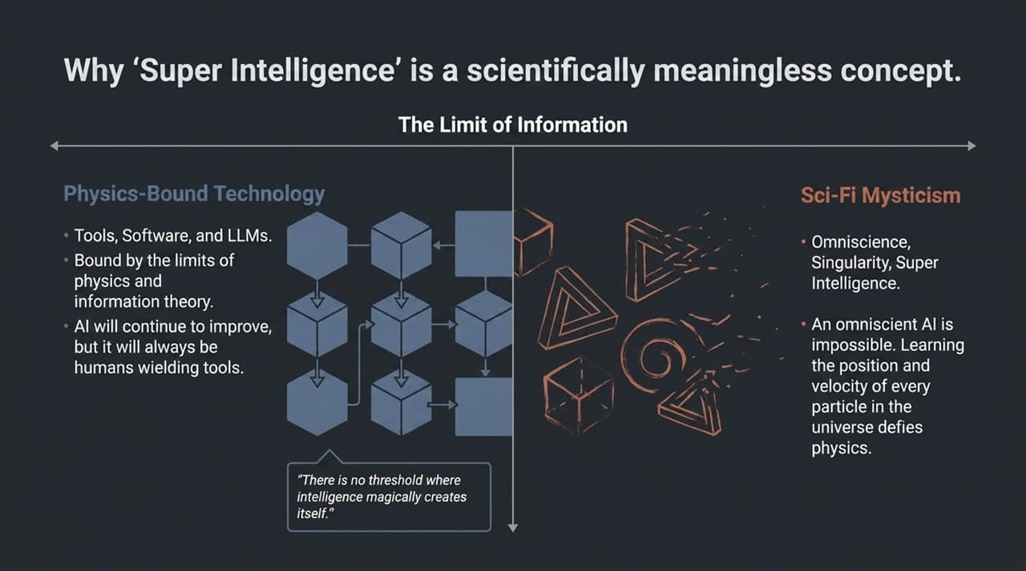
Notes:
Moving to Slide 3, we arrive at the central principle of this guide: The Reality of Engineering.
Progress does not happen by magic or cosmic destiny. And artificial intelligence is not an immortal being waking up in a lab. Both are physical processes driven by human problem-solving, bound strictly by the laws of physics and thermodynamics.
When we talk about AI development, we are talking about software tools. Whether it is an algorithm assisting a doctor in medical diagnostics or optimizing computational throughput, these systems do not possess magical intentions. They are tools designed to process information faster and more effectively.
When tech executives talk about AI as if it’s an entity with a mind of its own, they are often building hype or driving investment valuation. But as rational observers, we must view AI through an engineering lens: What is the hardware power? What are the algorithmic constraints? What is the quality of the training data? Once you strip away the sci-fi branding, AI becomes an understandable, controllable, and manageable engineering tool.

Slide 4
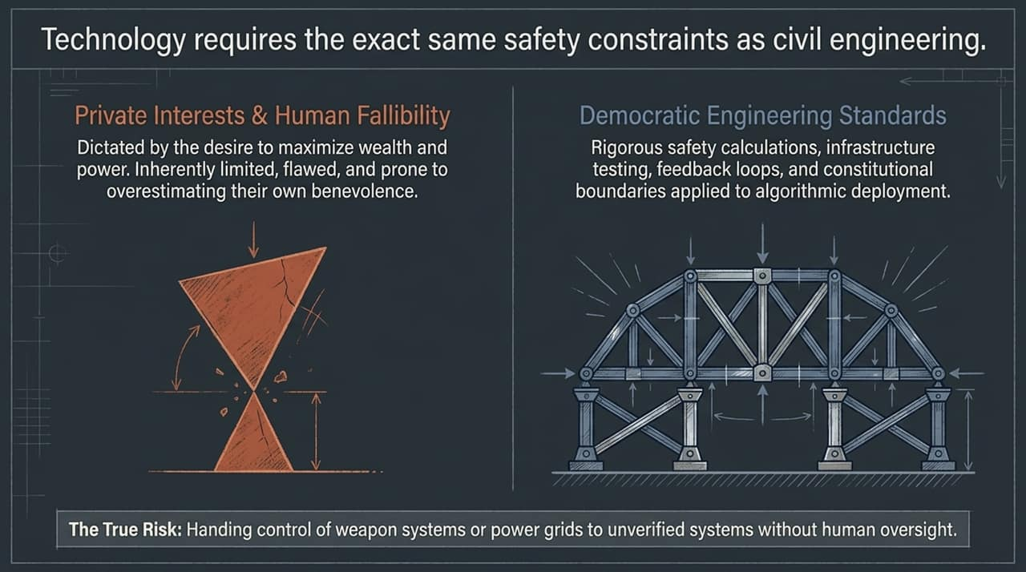
Notes:
Slide 4 addresses one of the most popular buzzwords in tech today: Super Intelligence.
In his interviews, Steven Pinker explicitly states that 'super intelligence' is a scientifically incoherent and meaningless concept. Why? Because intelligence is not a single, one-dimensional scalar quantity—like height or weight—that you can scale up to infinity.
On the right side of the slide, we see Sci-Fi Mysticism: concepts like Omniscience, the Singularity, or god-like Super Intelligence. True omniscience is physically impossible. Learning the precise position and velocity of every particle in the universe violates fundamental laws of physics and information theory. An AI system cannot 'know everything' or predict the complex future with absolute certainty because the real world contains physical chaos, hidden variables, and empirical limits.
On the left, we have Physics-Bound Technology. Yes, Large Language Models and specialized software will become dramatically more capable, efficient, and useful. Computers have surpassed human capabilities in specific domains since the 1950s—that's why we built them! But there is no magical threshold where code suddenly transcends physical constraints to become omnipotent. AI will continue to improve, but it will always remain what it has always been: humans wielding advanced tools.

Slide 5
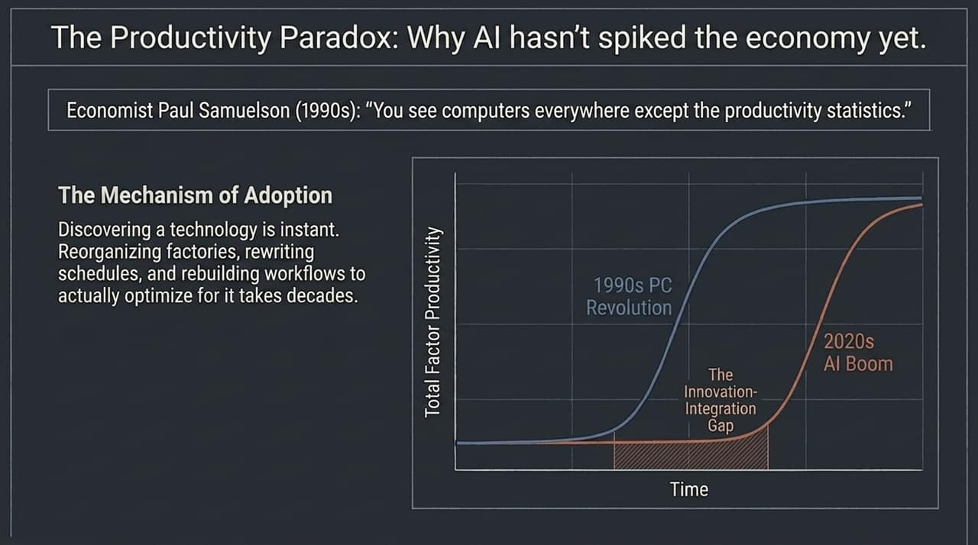
Notes:
If AI isn't an existential demon, does that mean there are no risks? Absolutely not. But the nature of the risk is vastly misunderstood.
Slide 5 compares Private Interests with Democratic Engineering Standards.
Human beings—including tech founders and CEOs—are inherently fallible, flawed, and prone to overestimating their own benevolence and wisdom. One of the foundational principles of democracy is that we never grant unchecked power to any group, whether they are kings, politicians, or tech barons. Corporations naturally seek to maximize profit and power, sometimes at the expense of public safety.
Therefore, we must treat AI safety the exact same way we treat civil engineering. You cannot build a suspension bridge or a nuclear power plant without rigorous safety calculations, stress tests, structural feedback loops, and legal compliance.
The real danger of AI isn't an autonomous machine 'waking up' and deciding to wipe out humanity. The real danger is human stupidity—recklessly handing over control of critical infrastructure, power grids, or automated weapon systems to unverified, untested algorithms without human oversight. We don't need mystical AI panic; we need strict, enforceable engineering standards.

Slide 6
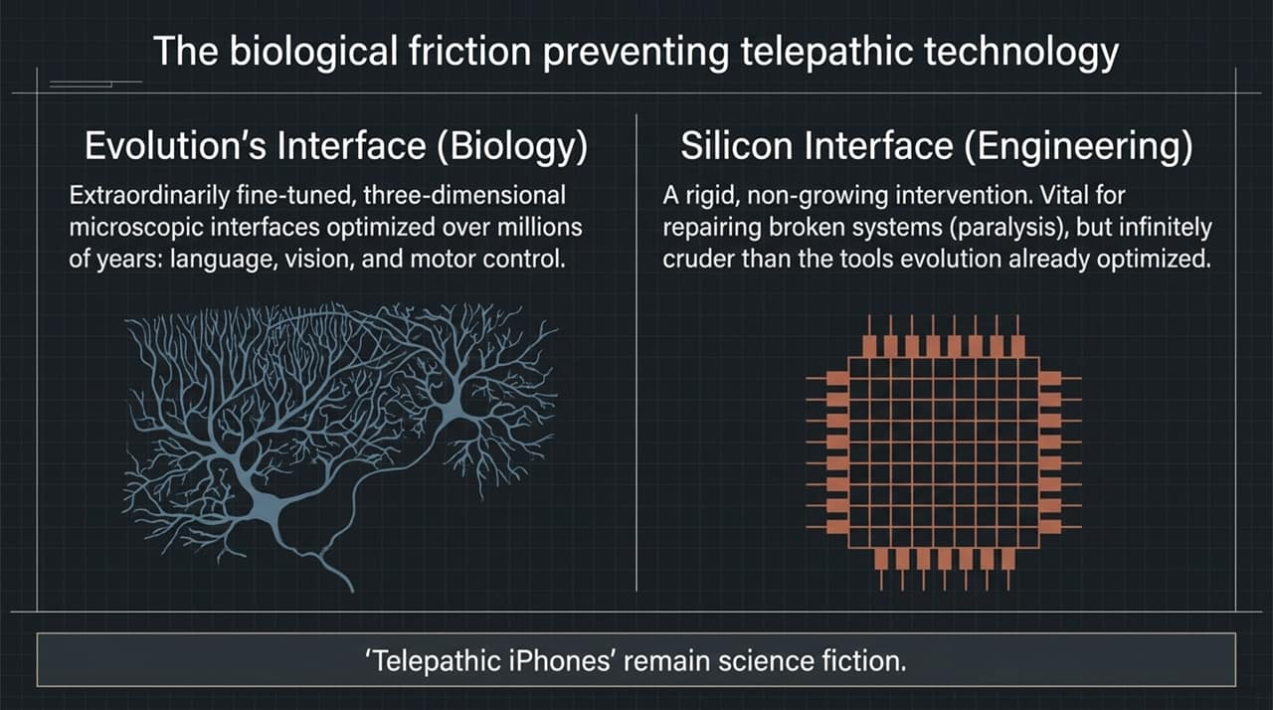
Notes:
Slide 6 focuses on an economic puzzle: If AI is already so powerful, why hasn't it noticeably spiked macro-economic productivity stats yet?
To answer this, we look to economic history. In the 1990s, Nobel laureate economist Paul Samuelson famously noted: 'You see computers everywhere except the productivity statistics.'
This is known as the Productivity Paradox. Discovering or deploying a new technology happens quickly, but reorganizing an entire economy to actually optimize for it takes decades.
Think back to the advent of electricity. When factories switched from steam engines to electric motors, productivity didn't jump immediately. Factory managers had built their entire physical layouts around central steam drive-shafts and belts. It took decades to physically redesign factories around modular electric units. The same thing happened with personal computers in the 1980s and 90s, where workers spent hours setting up printers or formatting documents before true workflow efficiency kicked in.
Today, we are in the 'Innovation-Integration Gap' for AI. While individual users experience productivity gains, enterprise integration, workflow restructuring, training, and risk management take time. The economic surge will come, but it follows the historical S-curve of technological adoption rather than an instant overnight boom.

Slide 7
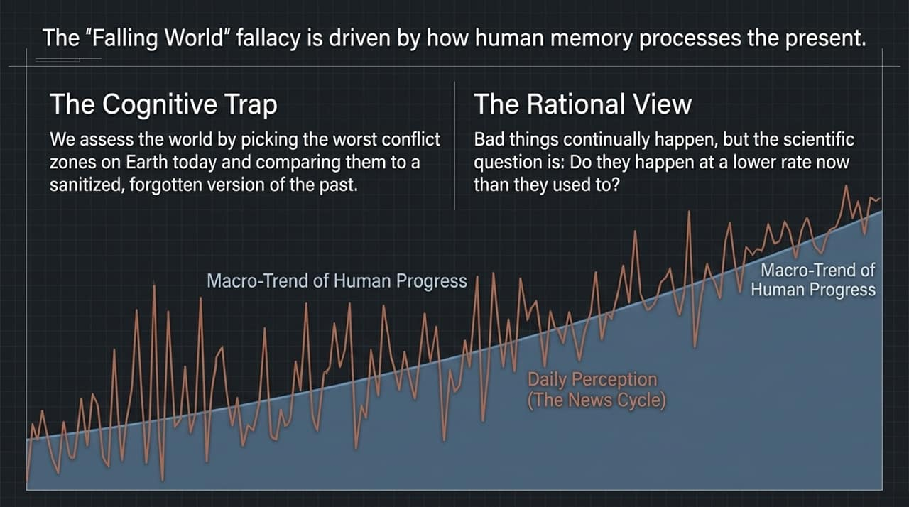
Notes:
Slide 7 addresses another sci-fi trope often promoted by tech futurists: direct brain-computer interfaces or 'telepathic' devices.
Here, we must understand the fundamental biological friction between nature's interface and silicon hardware.
Millions of years of natural selection have engineered human biology with extraordinarily fine-tuned, high-bandwidth three-dimensional interfaces. Our eyes, motor control, vocal apparatus, and language instincts process vast streams of information seamlessly.
Silicon chips, by contrast, are rigid, non-growing intervention structures. When used for medical restoration—such as helping a paralyzed person move a robotic limb or allowing a blind person to perceive light—surgical implants are incredible, life-changing breakthroughs. Because in those cases, the natural pathway is broken, so any functional link is a net win.
But for healthy humans, drilling holes into skulls to install non-growing silicon chips to control an iPhone by thought remains highly impractical and unnecessary. Our existing sensory interfaces—vision, speech, and touch—are vastly superior to any crude chip interface we can currently manufacture.

Slide 8
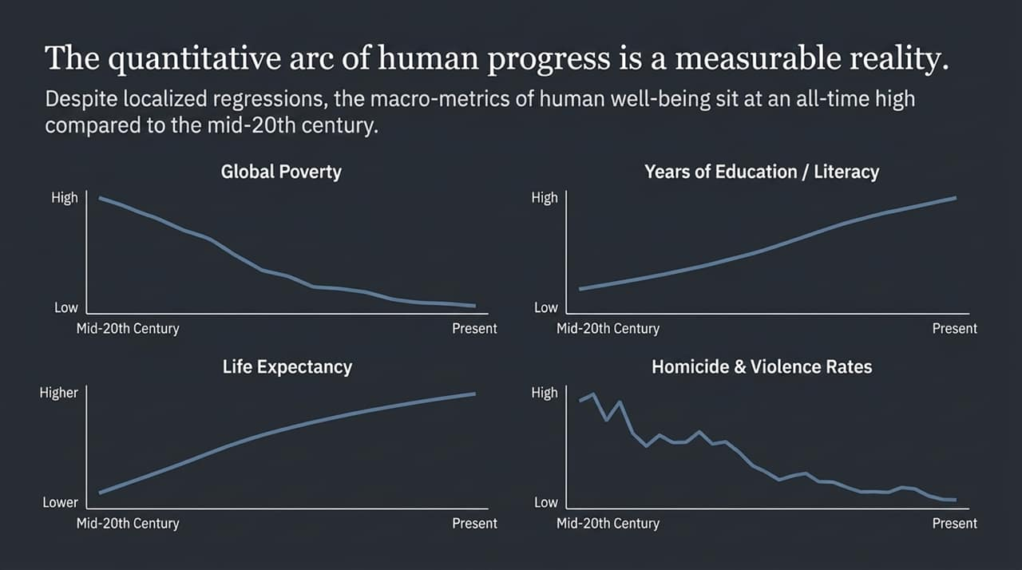
Notes:
Slide 8 returns to human psychology and explains The 'Falling World' Fallacy. Why do so many people consistently believe that society is decaying, even when measurable metrics prove otherwise?
This is caused by a cognitive trap in human memory processing. When we evaluate the state of the world, we naturally look at active crisis points—where war, crime, or disaster is occurring right now—and compare that vivid image against a sanitized, nostalgic version of the past.
As Steven Pinker notes in the interview, if you judge the world by picking the absolute worst conflict zone on Earth today, you will obviously conclude that world peace is impossible. But that is a selection bias error.
The rational, scientific method asks a different question: Are bad events occurring at a lower rate today per capita than they did 50, 100, or 500 years ago?
When you evaluate the macro-trends, the answer is clear. While short-term spikes and regressions occur due to political shocks or conflict, the underlying macro-trend of human progress moves steadily upward over time.

Slide 9
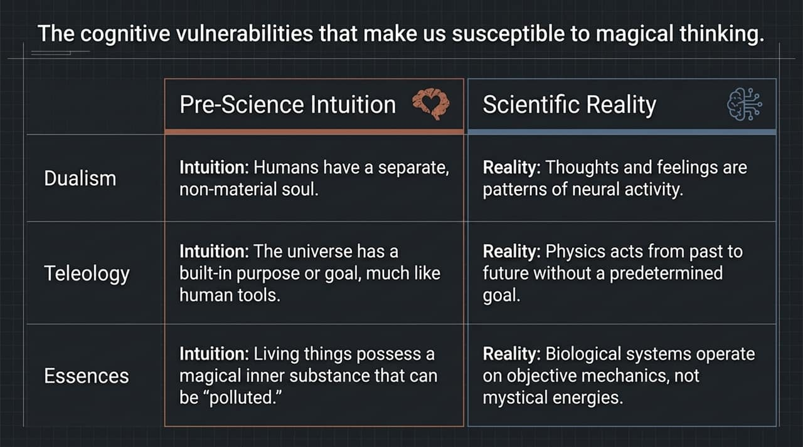
Notes:
Slide 9 provides the empirical evidence backing up our previous slide. The quantitative arc of human progress is not a matter of opinion or political belief; it is a measurable reality.
Let's look at the four major metrics tracked on this chart from the mid-20th century to the present:
Global Poverty: Extreme poverty has plummeted globally. Two centuries ago, over 90% of the world's population lived in extreme poverty. Prior to recent shocks, that figure fell below 10%.
Literacy and Education: More human beings—especially young women—have access to formal schooling and basic literacy today than at any point in recorded history.
Life Expectancy: Thanks to modern medicine, public sanitation, and agricultural efficiency, average global life expectancy has doubled over the past century.
Homicide & Violence: Despite dramatic news cycles, historical data shows long-term structural declines in per-capita homicide rates, war casualties, and interpersonal violence compared to earlier centuries.
Progress does not mean that everything is perfect, nor does it mean that progress is automatic. Progress is the result of applying human intelligence and rational problem-solving to concrete challenges.

Slide 10
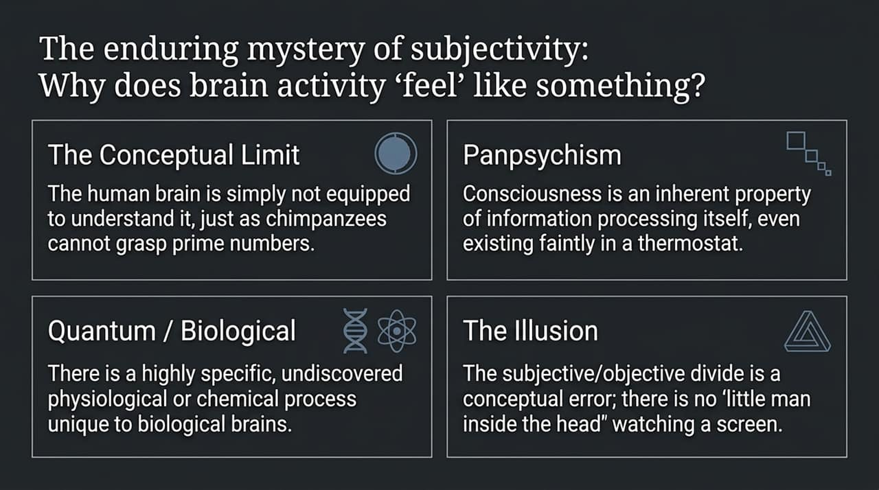
Notes:
Why are human beings so susceptible to technological hype, conspiracy theories, and magical thinking? Slide 10 breaks down our evolutionary cognitive vulnerabilities.
Before modern science, the human brain evolved intuitive heuristics to navigate the world. These intuitions served us well in small tribal groups, but they conflict with scientific reality:
Dualism: Our natural intuition tells us that mind and body are separate—that we possess a non-material soul. Scientific reality shows that thoughts, feelings, and consciousness are products of neural network activity in the brain.
Teleology: We intuitively assign goal-directed purpose to everything. We ask, 'Why was the universe created?' or 'What is nature's goal?' Physics shows that nature acts from cause to effect without a predetermined purpose.
Essences: We tend to believe living things contain a magical inner substance or 'essence' that can be corrupted. Modern biology demonstrates that biological systems operate on physical mechanics.
When we encounter artificial intelligence, these pre-scientific cognitive vulnerabilities lead us astray. We naturally project dualism and teleology onto software, assuming LLMs have inner souls, desires, or cosmic intentions. Rationality requires catching ourselves when we slip into these intuitive traps.

Slide 11
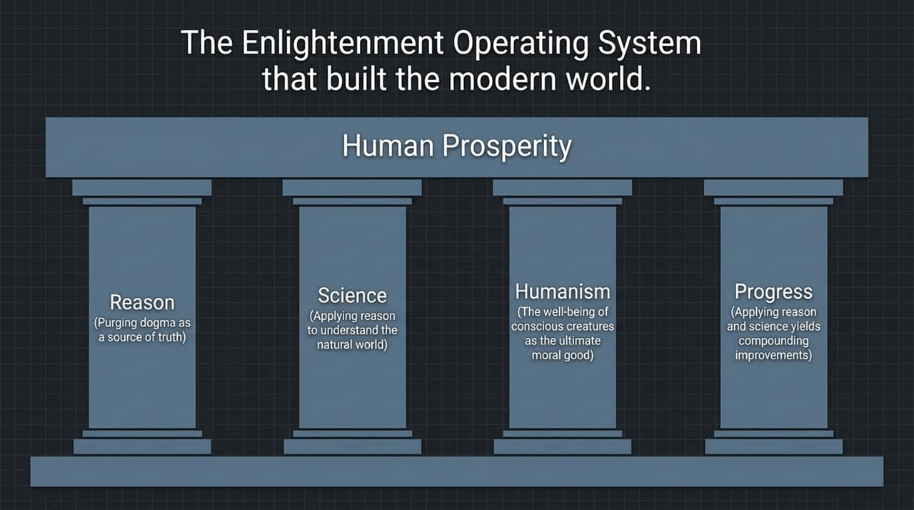
Notes:
Slide 11 examines one of the deepest philosophical questions in cognitive science: Why does brain activity 'feel' like something? Why do we have subjective, first-person experiences?
In his discussion on consciousness, Pinker notes that while objective neurobiology can explain how the brain processes information, the hard problem of subjectivity remains open. Four main hypotheses exist:
The Conceptual Limit: Human minds may simply lack the cognitive architecture to intuitively understand how physical matter produces subjective feeling—just as a chimpanzee cannot grasp prime numbers.
Panpsychism: The idea that consciousness is an intrinsic property of all information processing, existing in microscopic degrees even in simple mechanical systems like a thermostat.
Quantum / Biological Specificity: The theory that consciousness relies on highly specific, undiscovered biochemical or physiological processes unique to biological neural structures.
The Illusion (Dennett's View): The stance that the subjective/objective divide is a conceptual mistake. There is no 'homunculus' or little person inside the brain watching an internal screen.
Understanding these limits helps us evaluate claims about 'AI consciousness.' Generating grammatically correct text or simulating conversation is sophisticated information processing, but it should not be confused with biological awareness.

Slide 12
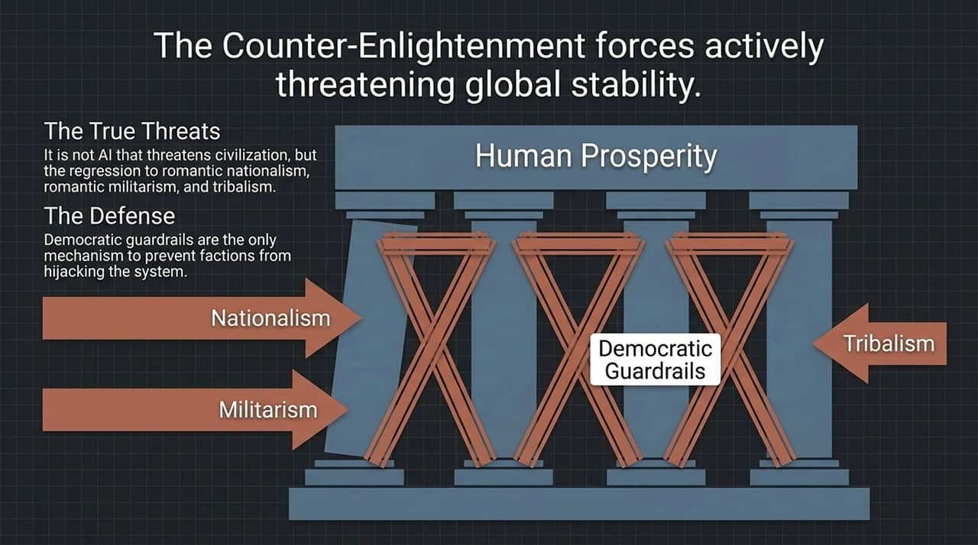
Notes:
Slide 12 introduces The Enlightenment Operating System—the framework that constructed the modern world.
Developed during the 17th and 18th centuries, this framework relies on four interdependent pillars to drive human prosperity:
Reason: The agreement that dogma, revelation, authority, and tribal myths must be purged as sources of truth. Ideas must be evaluated through critical inquiry and evidence.
Science: The disciplined application of reason to understand the natural world through empirical testing and correction.
Humanism: The moral principle that the well-being of conscious creatures is the ultimate moral good—not national glory, religious dogma, or corporate profit.
Progress: The understanding that combining reason, science, and humanism yields continuous, compounding improvements in human welfare.
This operating system built modern medicine, democratic governance, human rights, and technological innovation. As we enter the AI era, we do not need to invent a new moral framework; we need to defend and run this proven operating system.

Slide 13
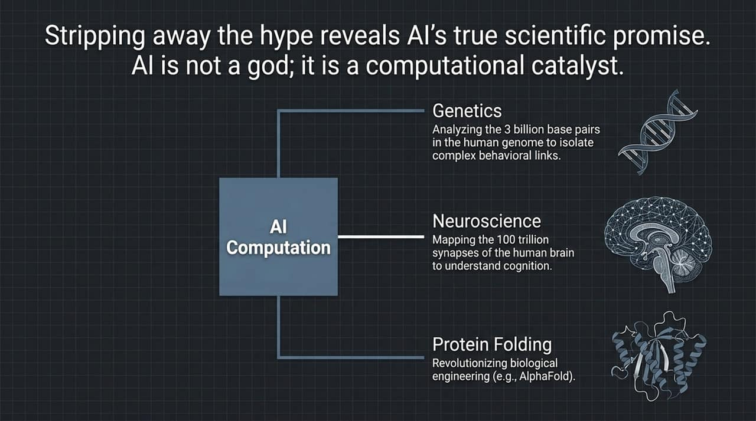
Notes:
Slide 13 provides a clear reality check for navigating the 21st century.
First: Technology is a tool, not a miracle.
We must stop treating artificial intelligence as a mystical force. AI is a computational technology. It requires rigorous engineering standards, empirical verification, legal accountability, and clear boundaries—just like aviation, pharmaceutical development, or civil engineering.
Second: Progress is a project, not a given.
Progress does not happen automatically by passive evolution. It is an ongoing human project that requires constant effort, vigilance, and problem-solving. We must actively defend Reason, Science, and Humanism against counter-Enlightenment forces like tribalism, authoritarianism, and doom-saying pessimism.

Slide 14
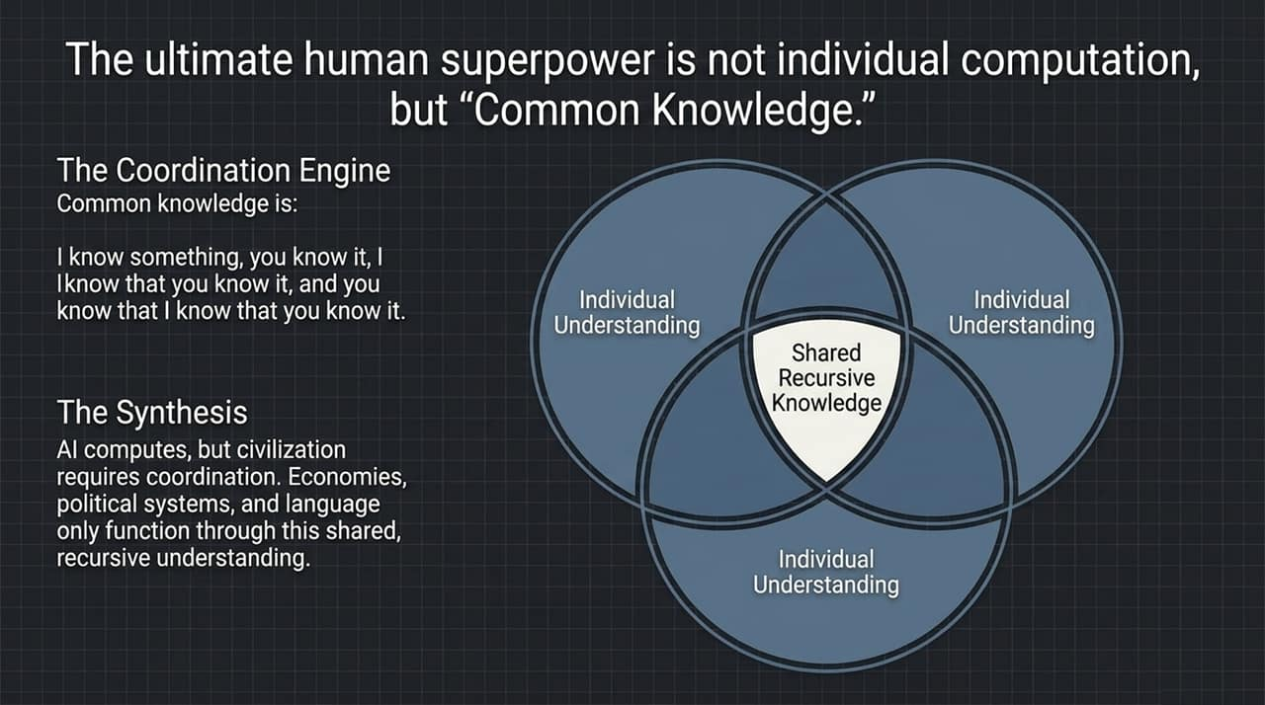
Notes:
Slide 14 synthesizes Steven Pinker’s rationalist perspective on AI and society.
On the left, under AI: Machine, Not Miracle:
'Superintelligence' is an Incoherent Category: AI will grow more capable, but it will never become omniscient. It remains an advanced tool.
Engineering Safety Standards: AI requires rigorous safety calculations, testing, and accountability.
The Productivity Paradox: Economic gains take time as institutions adapt.
On the right, under The Pillars of Progress:
Global Well-being is High: Measurable metrics confirm long-term gains in human welfare.
Reason, Science, & Humanism: These values prioritize human welfare over dogma.
Democracy as a Constraint on Power: Because human beings are fallible, we need legal checks and balances on both government authorities and corporate leaders.

Slide 15
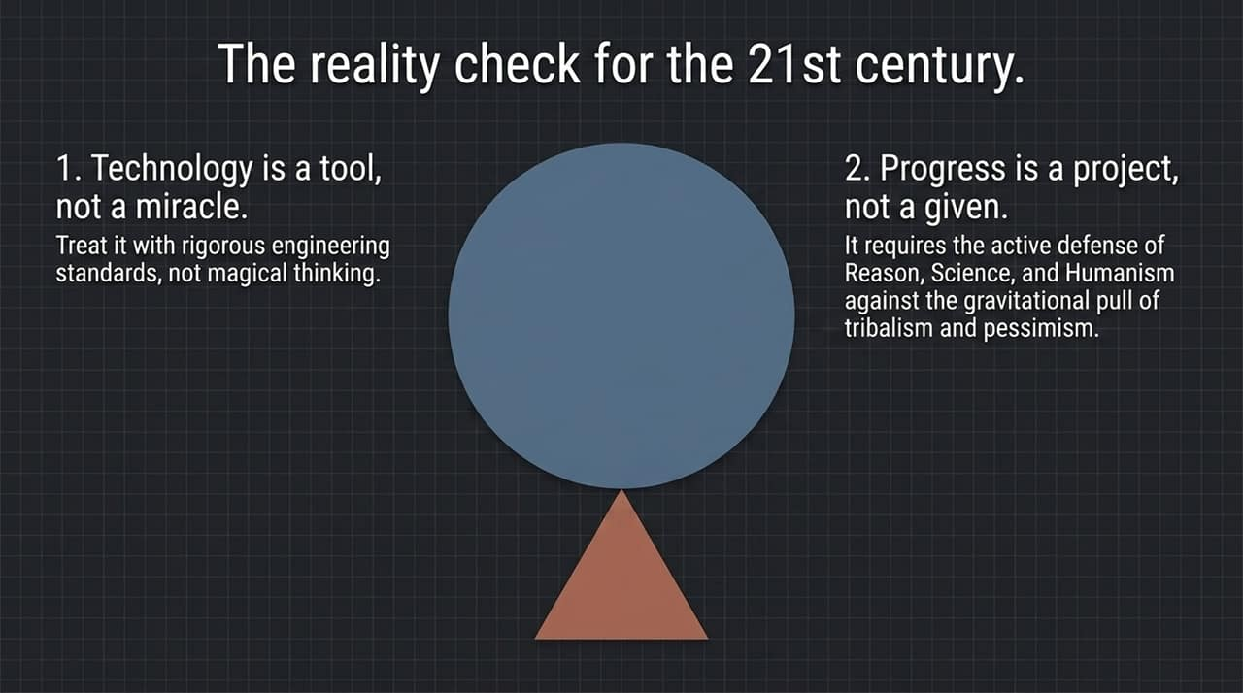
Notes:
Slide 15 summarizes empirical global trends:
Life Expectancy: Continual long-term increase, reaching historical highs.
Global Poverty: Continual long-term decrease, standing at historic lows.
Education & Literacy: Continual increase worldwide.
Maintaining a clear view of these data points protects us from historical amnesia. It reminds us that human problem-solving works when grounded in empirical evidence and rational policy.

Slide 16
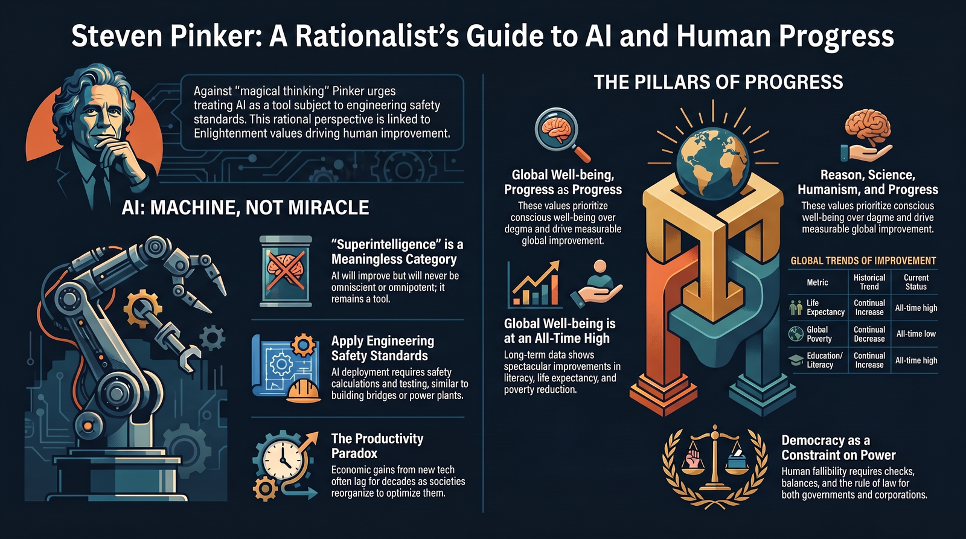
Notes:
To conclude our presentation on Slide 16, let’s summarize our core message.
We do not need to fear AI as an existential monster, nor should we worship it as a savior. AI is a powerful tool built by human engineering.
To navigate the AI era successfully, we must:
Reject technological mysticism and evaluate software objectively based on physical capabilities and limits.
Apply democratic engineering standards to hold tech developers accountable and protect critical public infrastructure.
Reclaim the Enlightenment operating system—using Reason, Science, and Humanism to ensure technology serves the flourishing of conscious human beings.
Thank you very much.

